Slide 1
SoftReports
Common Table Expression
(CTE)
♫ SNUG 2014 ♫

Slide 2
CTE Definition
A Reusable Collection of Prebuilt Expressions
An Expression Can be:
A Field from a Table or View dual.Dummy
A Piece of Code
TRUNC(sysdate, ‘YYYY’) - 7
A Constant Expression
‘ABC’, 123, ‘etc. etc. etc.’

Slide 3
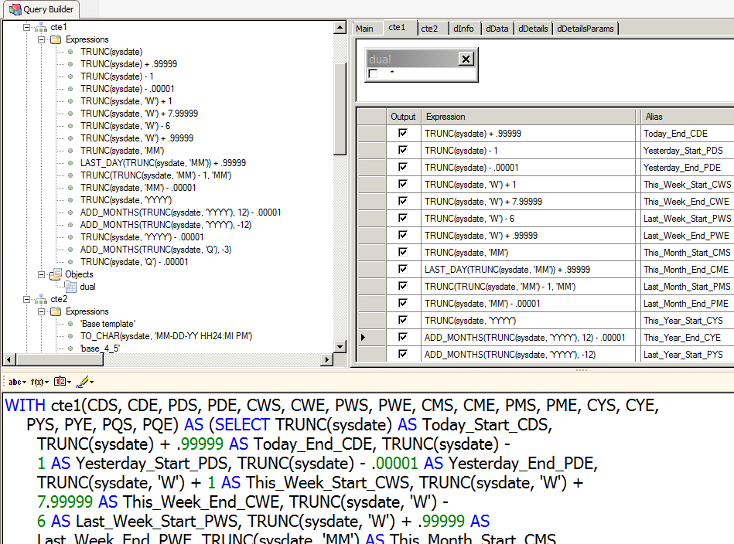
Prebuilt Collection of Expressions
cte1

Slide 4
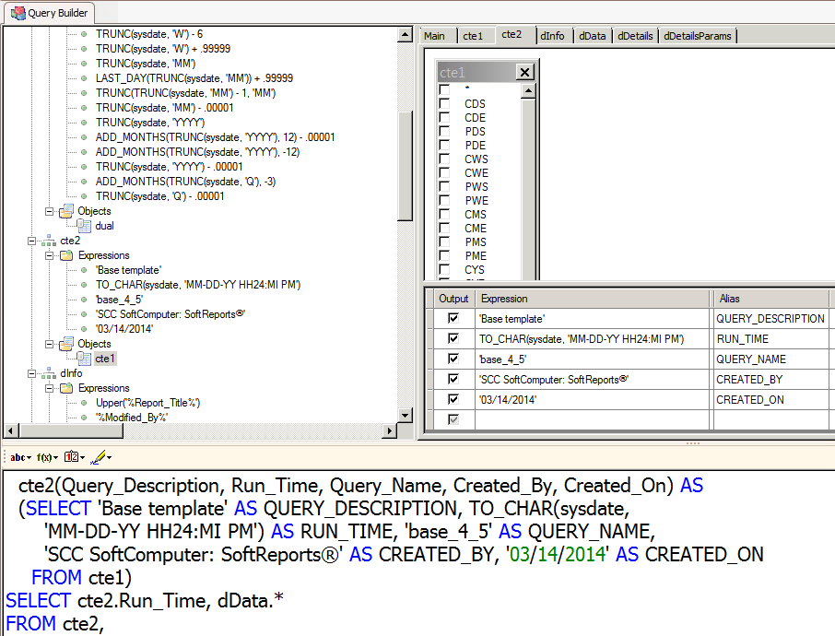
Prebuilt Collection of Expressions
cte2

Slide 5
Common Table Expressions
Usage
A CTE Can be Used for:
Start/End Period Criteria
Documentation of a Query
Purpose, Version, Author, etc.
Common Expressions
Run Time, Title, etc.

Slide 6
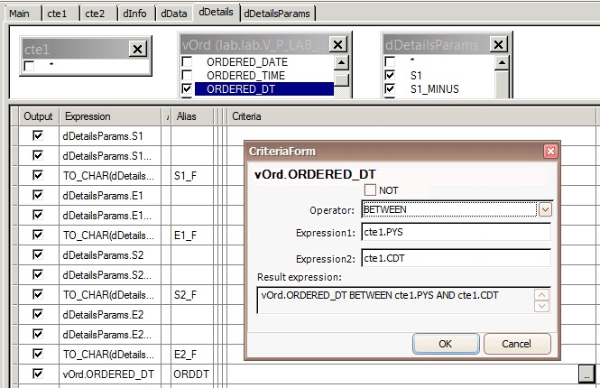
Start/End Period
BETWEEN
cte1.PYS and cte1.CDT

Slide 7
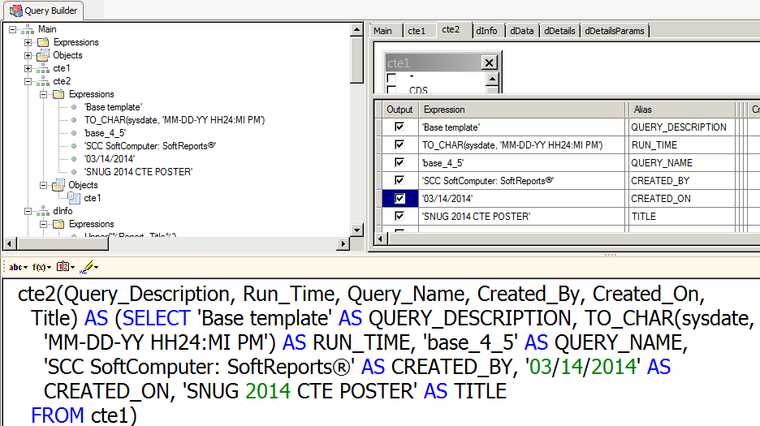
Query Documentation
cte2.Created_On

Slide 8
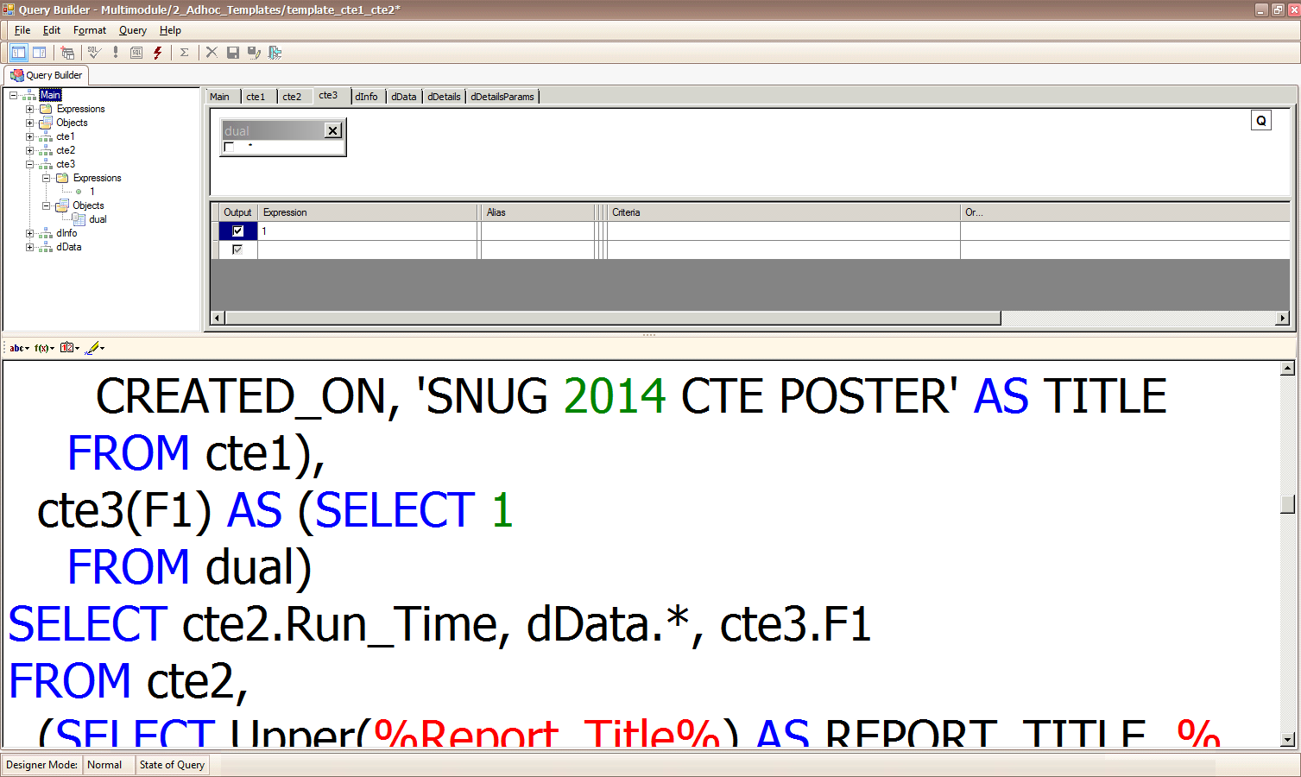
Common Expressions
cte3.F1 = 1

Slide 9
Building and Using a Common Table Expression
Right click in the Objects Pane of the Query Builder

Slide 10
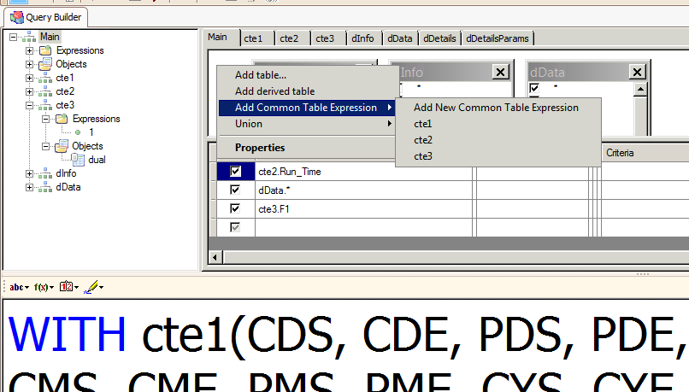
New or Prebuilt CTE
Adding a CTE Options
See the SoftReports 1.1.9 User Manual

Slide 11
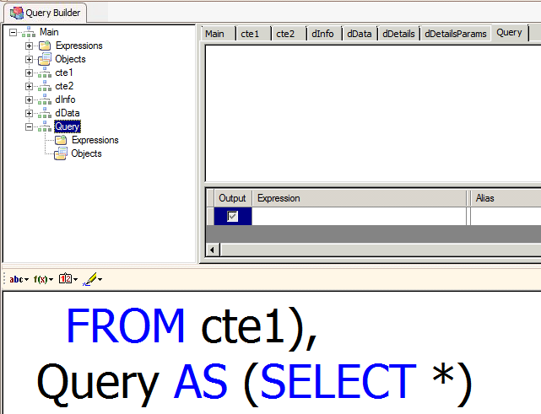
Rename the New CTE in the SQL Edit Pane

Slide 12
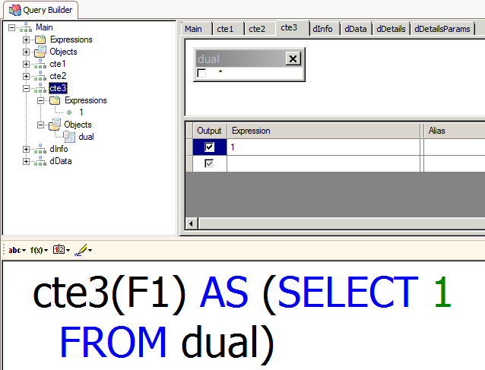
Alias F1 for
Expression 1
FROM dual
NOTE: use the SQL edit pane to add the alias list and the dual object to the new CTE you created

Slide 13
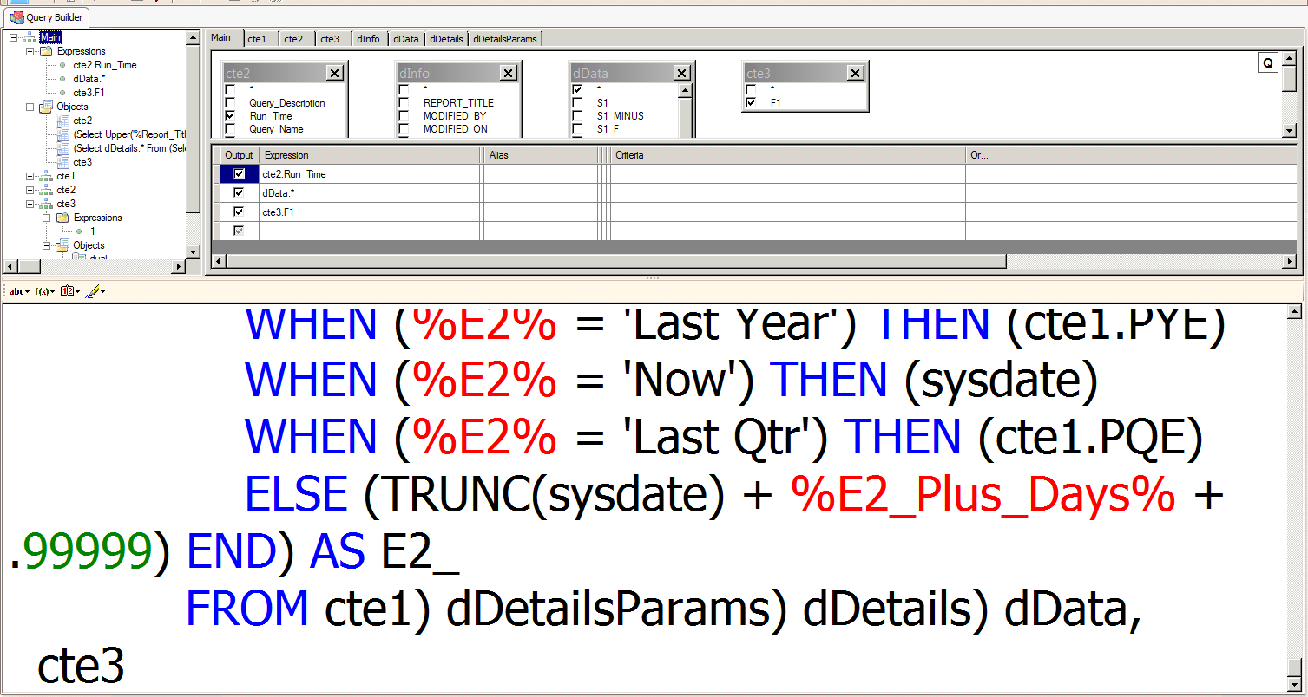
Rename the CTE object in the SQL Edit Pane

Slide 14
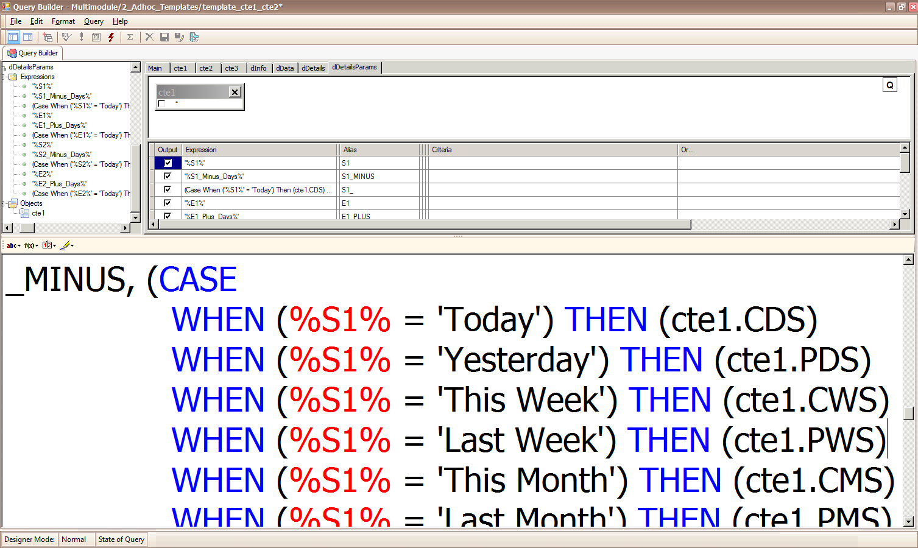
Using a Prebuilt CTE in a Case When Statement

Slide 15
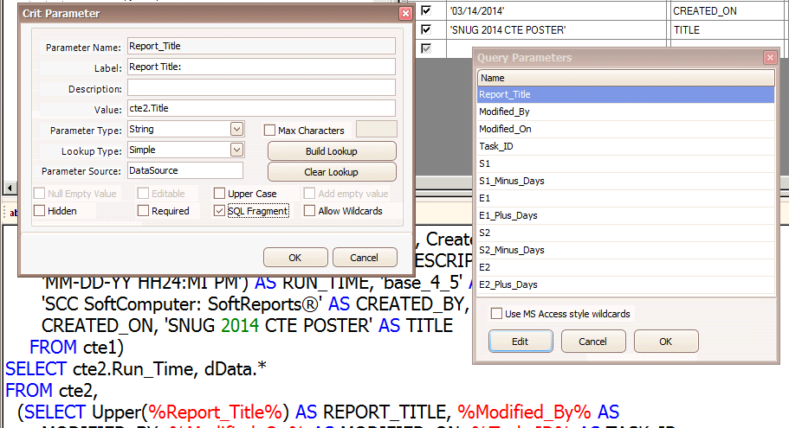
Using a Prebuilt CTE as a SQL Fragment in a Parameter

Slide 16
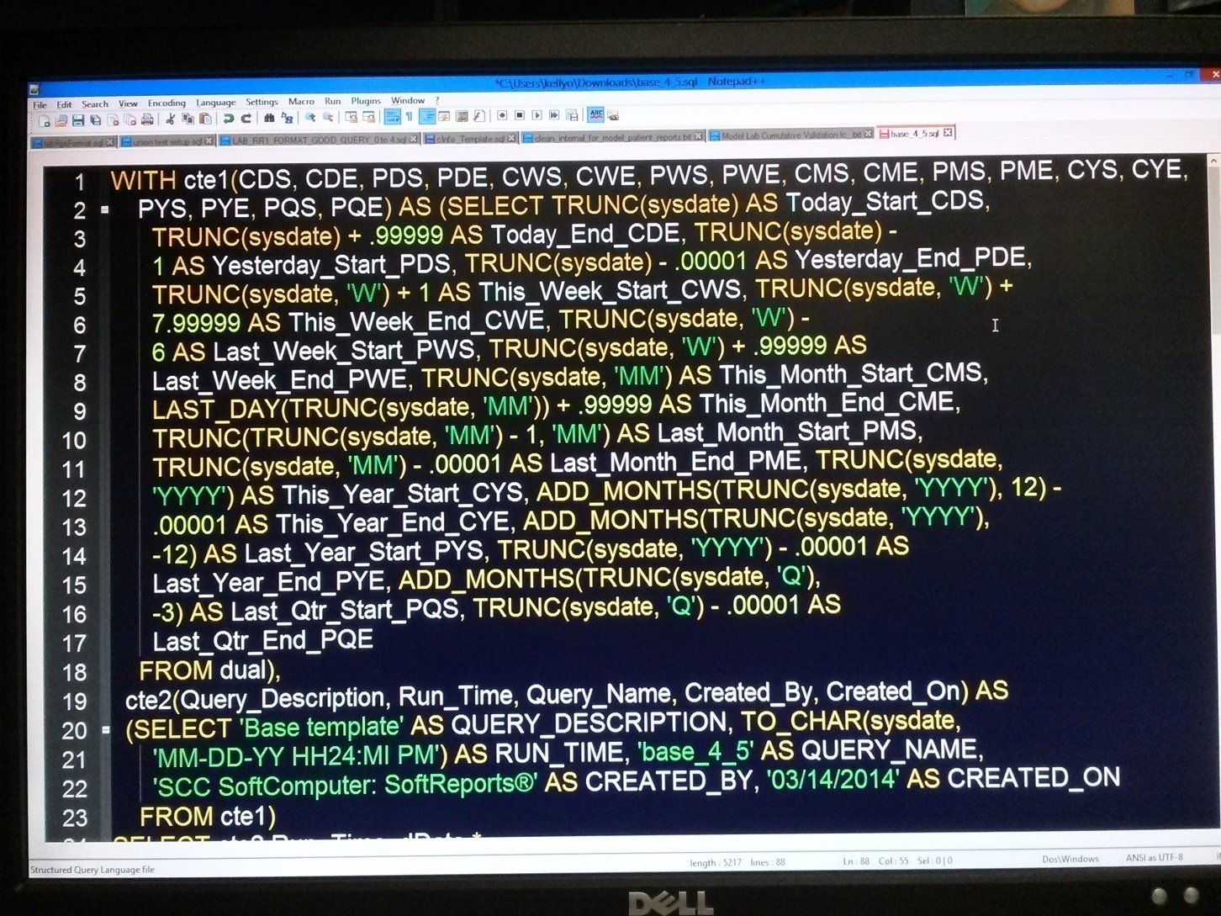
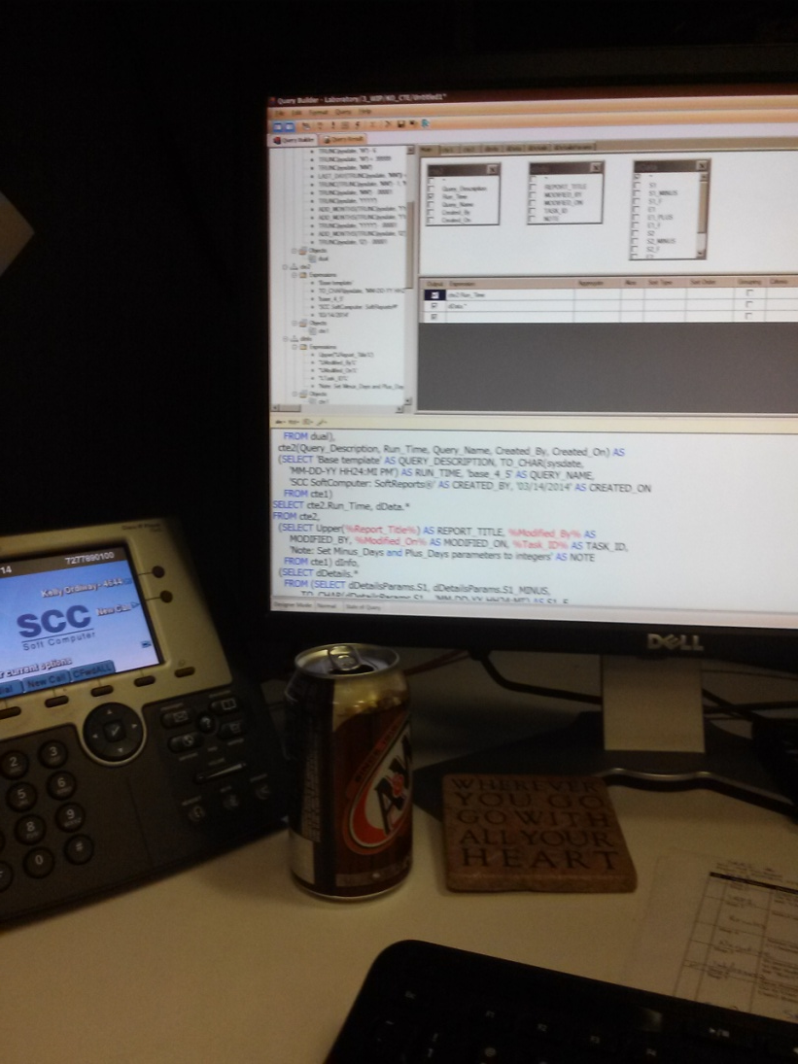
SoftReports
Common Table Expressions Rock!

